Slide 1


Modeling: Electric Circuits RLC-Circuit

Slide 2
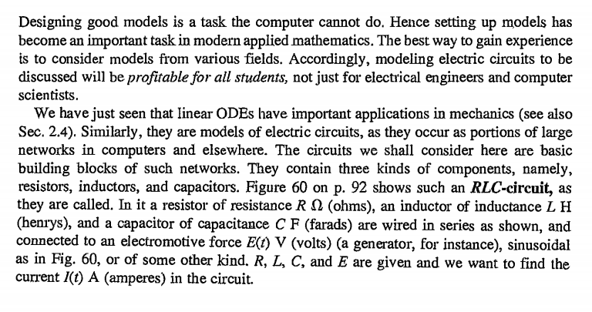
RLC-Circuit

Slide 3
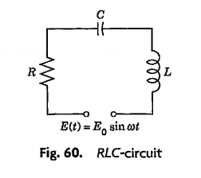

Slide 4
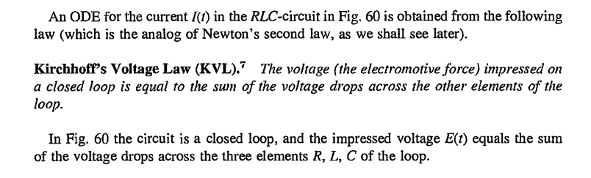
LAWS

Slide 5
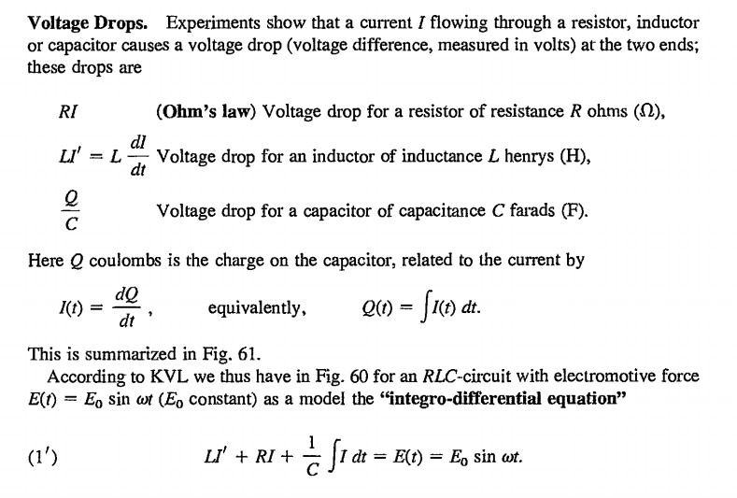

Slide 6


Slide 7




















Slide 8
























Slide 9
































Slide 10


Slide 11


Slide 12


Slide 13


Slide 14
